Slide 1
Digital Portfolio
STUDENT NAME: ASWITHA A
REGISTER NO AND NMID: asunm115212400300
DEPARTMENT: BCA(COMPUTER APPLICATION)
COLLEGE: SRI SUBRAMANIYA SWAMY ARTS COLLEGE

Slide 2
PROJECT TITLE
Smart Portfolio Management System

Slide 3
AGENDA
1. Problem Statement
2. Project Overview
3. End Users
4. Tools and Technologies
5. Portfolio design and Layout
6. Features and Functionality
7. Results and Screenshots
8. Conclusion
9. GitHub Link

Slide 4
PROBLEM STATEMENT
Students struggle to showcase academic, technical, and project skills
effectively.
Lack of a centralized digital space to present achievements.
Recruiters find it difficult to evaluate students work beyond resumes.
Traditional career guidance methods are generic, not personalized.
Digital transformation demands smarter, AI-based solutions for employability.

Slide 5
PROJECT OVERVIEW
A digital portfolio system designed for students.
Allows storing and showcasing skills, certifications, projects, and
achievements.
Provides recruiters with a structured, user-friendly profile or candidates.
Enhances employability through interactive, professional portfolio design.
Integrates real-time job market insights to guide students towards
high-demand careers.

Slide 6
End users
Students – to display their academic & project work.
Recruiters or Companies – to evaluate student profiles easily.
Colleges or Universities – to maintain digital records of student achievements.
Career Counselors – to provide data-driven, personalized guidance.

Slide 7
TOOLS AND TECHNIQUES
Frontend: HTML, CSS, JavaScript, React
Backend: Node.js or Django or Flask
Database: MySQL or MongoDB
Version Control: Git & GitHub
Design Tools: Figma or Canva

Slide 8
PORTFOLIO DESIGN AND LAYOUT
Homepage – Student introduction, highlights.
Projects Section – Detailed case studies with images.
Achievements – Certifications, competitions.
Contact Section – Email, Linkedln, Github link.

Slide 9
FEATURES AND FUNCTIONALITY
User authentication & profile management.
Upload and update projects dynamically.
Searchable, filterable portfolio.
Mobile-friendly responsivr design.
Intergration with LinkedIn & GitHub.

Slide 10
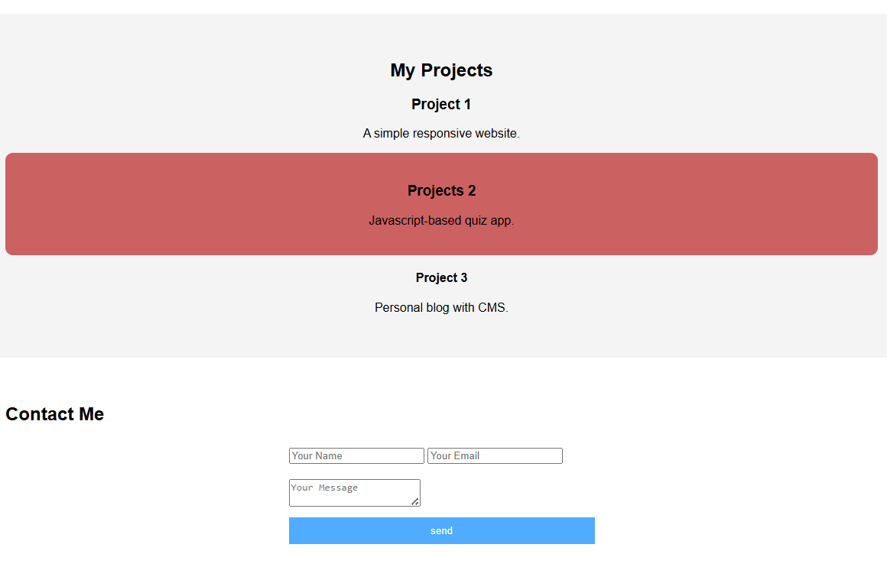
Results and screenshots
Successfully built a working prototype.
Results of my Portfolio

Slide 11
Results and screenshots
Successfully built a working prototype.
Results of my Portfolio

Slide 12
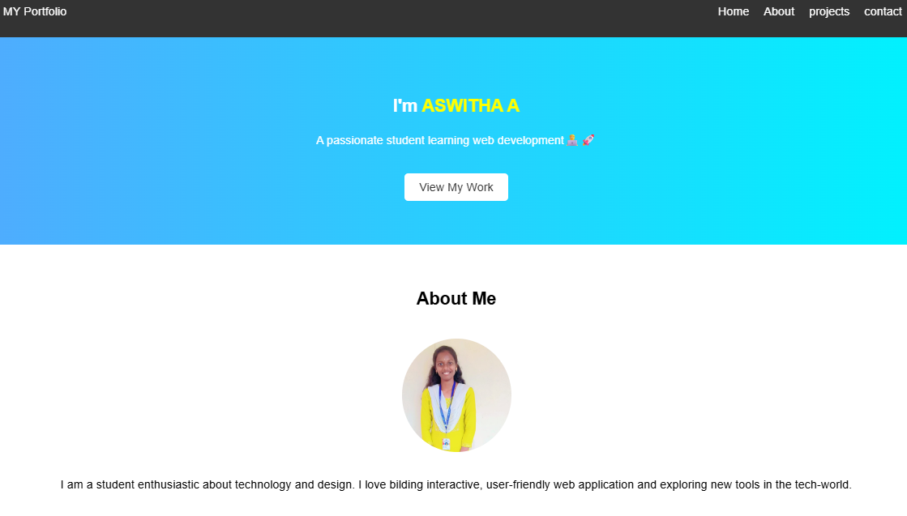
Results and screenshots
Successfully built a working prototype.
Results of my Portfolio

Slide 13
Conclusion
A digital portfolio provides an edge over traditional resumes.
Bridges the gap between students and recruiters.
Future scope: AI-based profile suggestions, analytics, and
auto-resume generation.
Scalable solution for colleges, universities, and job portals.

